Slide 1


Università degli Studi di Milano - Bicocca
Università della Svizzera Italiana
DOUBLE DEGREE
MASTER OF SCIENCE IN COMPUTER SCIENCE
Interpretation of Neural Networks
and Advanced Image Augmentation for
Visual Control of Drones in Human Proximity
Supervisors:
Prof. Alessandro Giusti
Prof. Giovanni Denaro
Master Thesis by
MARCO FERRI
iD 807130
Co-Supervisor:
Dr. Dario Mantegazza
Notes:
Hi everyone. I am pleased to present you my master thesis about Interpretation of Neural Networks and Advanced Image Augmentation for Visual Control of Drones.

Slide 2
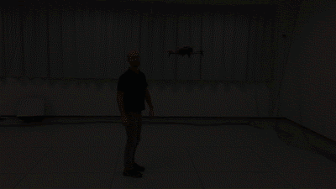


PROBLEM INTRODUCTION
HUMAN POSE ESTIMATION FOR FLYING A DRONE USING IMAGES FROM ITS CAMERA
ONLY WORKS IN
THE DRONE ARENA
ENHANCE MODEL'S GENERALIZATION
[Mantegazza et al. 2019]
GIF link
Notes:
We consider a machine learning approach to make a drone fly in front of a person, following its movements. We work on a previous research, which aims to estimate the human pose using images coming from the drone's camera. The main issue of the existing model is that it only works inside of the drone arena, that you see in the video, in which the dataset has been collected. Our goal is to allow the drone to fly in different environments, by enhancing the model generalization's capabilities.

Slide 3
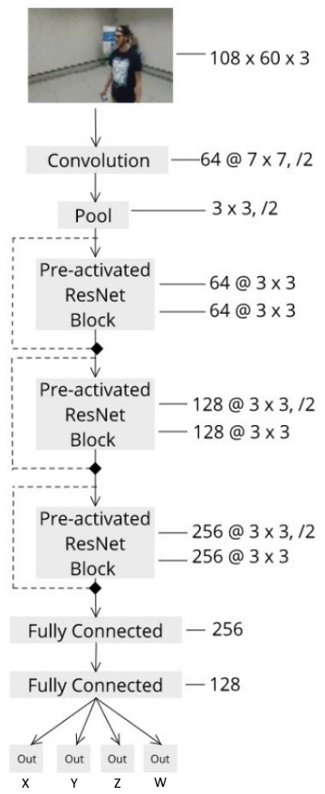
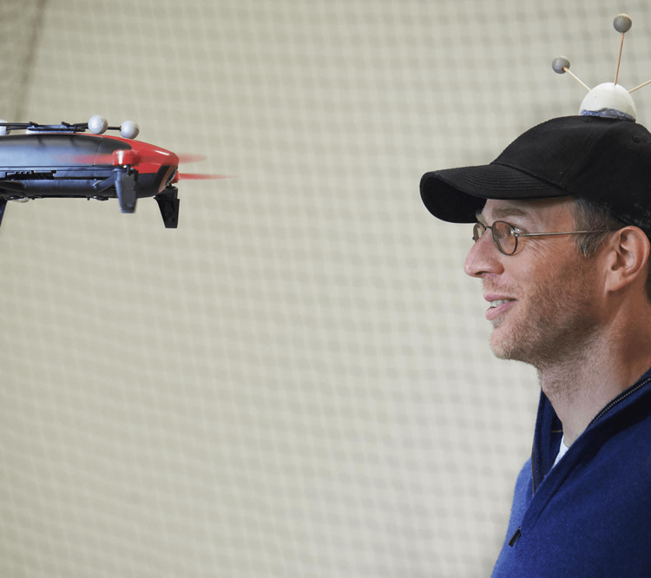
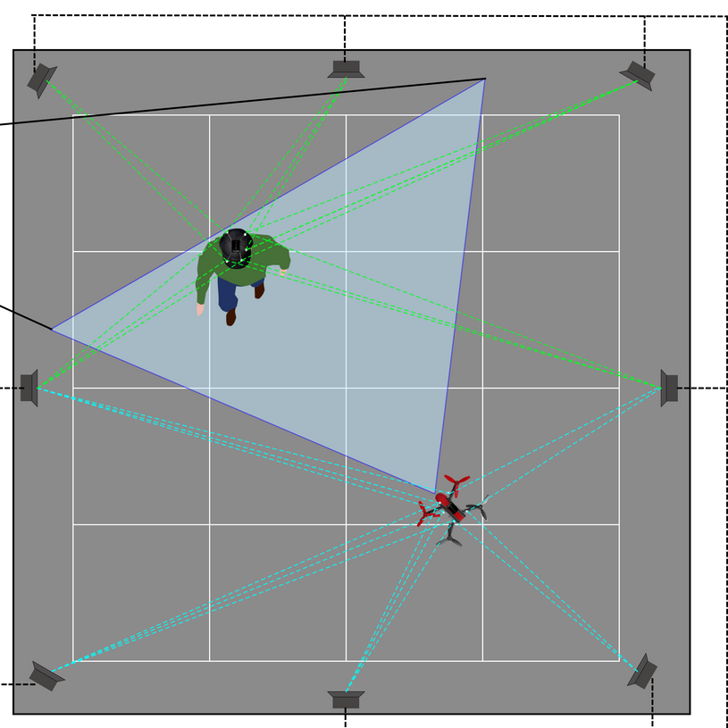
HOW THE SYSTEM WORKS
Supervised Learning
Regression on the User's 3D Coordinates - X, Y, Z, W
Motion Capture to acquire the GT
ResNet for processing images and learning the task
Notes:
Let's see how the system works. We are using supervised learning to perform a regression on the user's 3D coordinates X, Y, Z and YAW (called W). This approach requires a Motion Capture system for acquiring the ground truth using infrared cameras to track passive markers placed on the top of the drone's and person's head, as you see in the picture. For the task, we adopt a particular type of convolutional neural networks called ResNet. The architecture is shown on the right. The model takes in input the images from the drone's camera and outputs the 4 regression variables described before.

Slide 4
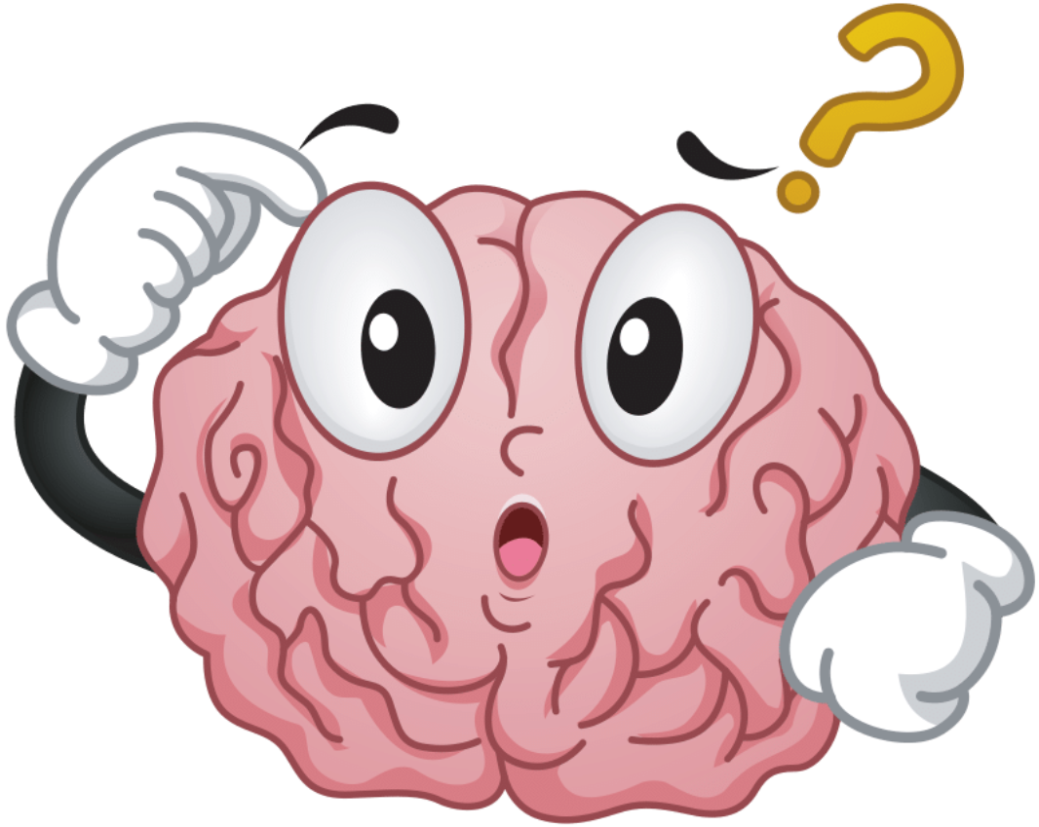


OUR CONTRIBUTION
MODEL
INTERPRETATION
AUGMENTATION
STRATEGY
MULTIPLE EVALUATIONS
TO FIND THE PROBLEM
TO GENERALIZE THE TASK
TO VALIDATE THE SOLUTION
Notes:
Our contribution to this project can be divided in 3 tasks. First of all, we try to interpret the model to find the actual problem with the learning. Then, we propose an augmentation strategy to generalize the task, and finally we run multiple evaluations for assessing our approach validity.

Slide 5
MODEL INTERPRETATION
TO FIND THE PROBLEM
Notes:
Let's get into the model interpretation, usually done through dedicated network interpretability techniques. Among the available, we choose GradCAM because it's easily understandable.

Slide 6
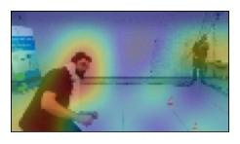
GRAD-CAM
HIGHLIGHTS THE REGIONS OF THE INPUT IMAGES
MOST RESPONSIBLE FOR THE NEURAL NETWORK'S OUTPUT
Notes:
In a few words, the algorithm is able to explain the model's predictions by producing a heatmap. This heatmap highlights the regions, or parts, of an input image that are most responsible for the neural network's output.

Slide 7
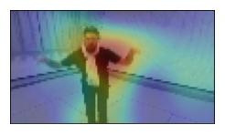
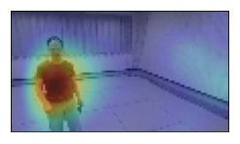
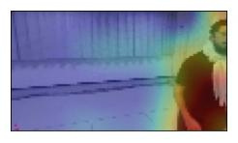
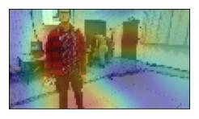
GRAD-CAM EXPECTED OBSERVATIONS
Notes:
By applying GradCAM for the given task, we expect to have heatmaps that overlay the users in the images, like in these examples. This is, because we want the network, to produce an output only based on the person in the image.

Slide 8
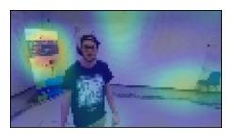
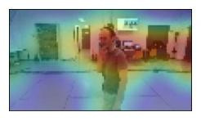
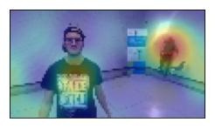
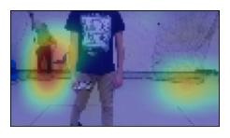
GRAD-CAM REVEALS: BACKGROUND OBJECTS
Notes:
However, things are different. In many cases, GradCAM reveals other elements of the room to be important for the network, such as people or objects in the background.

Slide 9
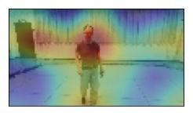
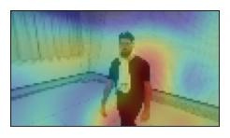
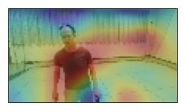
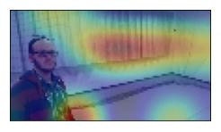
GRAD-CAM REVEALS: CURTAINS
Notes:
... curtains ...

Slide 10
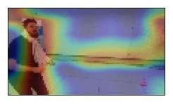
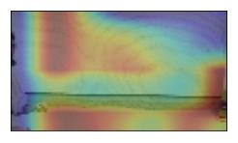
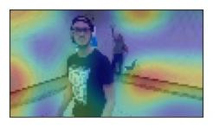
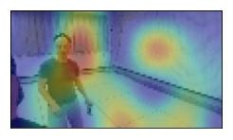
GRAD-CAM REVEALS: WALLS
Notes:
... or also the room borders like in these images. In other situations, even spots on the wall seem to receive attention from the network.

Slide 11
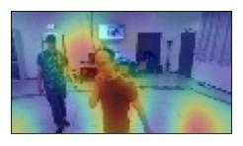
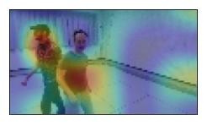
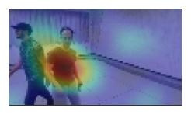
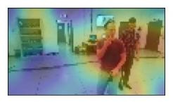
GRAD-CAM REVEALS: MULTIPLE PEOPLE
Notes:
And when multiple people are in front of the drone, the model doesn't know how to handle the issue.

Slide 12
GRAD-CAM SUMMARY
THE MODEL IS DEPENDANT ON THE DRONE ARENA
IN WHICH THE DATASET HAS BEEN COLLECTED
WE WANT TO ELIMINATE THE
OVERFITTING ON THE TRAINING SET
Notes:
We conclude that the model is dependant on the drone arena in which the dataset has been collected.
As a goal, want to remove the bias by reducing the overfitting on the training set.

Slide 13
AUGMENTATION STRATEGY
TO GENERALIZE THE TASK
Notes:
To do so, we introduce a custom augmentation strategy to make the model able to generalize the task.

Slide 14

AUGMENTATION STRATEGY
INSPIRED BY DOMAIN RANDOMIZATION
ORIGINAL
PHOTO
BACKGROUND REMOVED
BACKGROUND REPLACED
Notes:
Inspired by domain randomization, we define an approach that takes original samples from the dataset, removes their backgrounds and replaces them with new images.

Slide 15
AUGMENTATION STRATEGY: STEPS
MASKING THE USERS IN THE IMAGES
REPLACING WITH APPROPRIATE BACKGROUNDS
APPLYING CLASSIC IMAGE TRANSFORMATIONS
TRAINING THE MODEL ON AUGMENTED DATASET
Notes:
Our augmentation pipeline is composed of 4 steps.
We compute the users' masks in the dataset.
We replace the backgrounds with appropriate images.
We also apply classic approaches for image augmentation.
And we finally train the model on the augmented dataset.

Slide 16
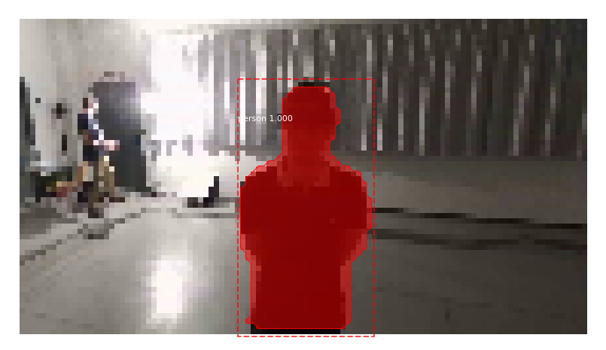
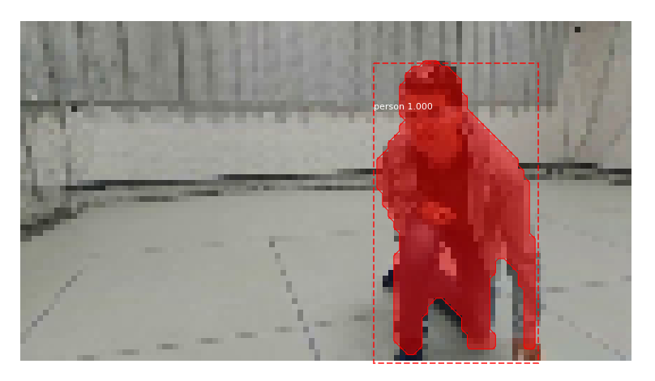
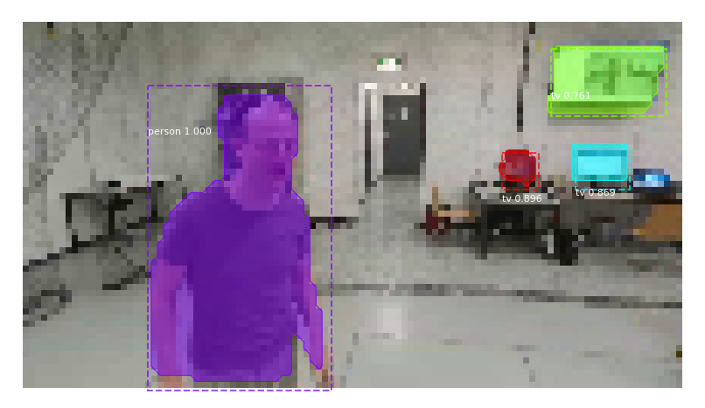
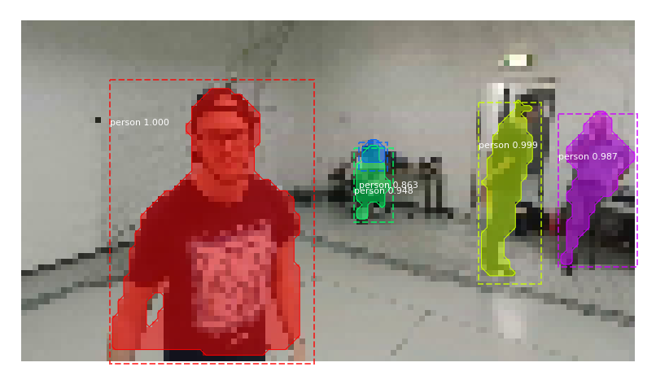
PERSON MASKING WITH MASK R-CNN
Notes:
For the masking, we tried several alternatives ending up with Mask R-CNN, a state-of-the-art framework for object detection and instance segmentation. Used on our dataset, it outperforms any other algorithm, being able to easily detect, classify and segment people in the camera's frames. This enables the possibility of replacing the backgrounds.

Slide 17
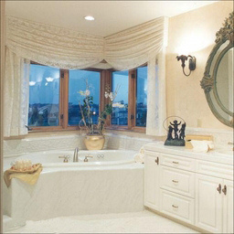
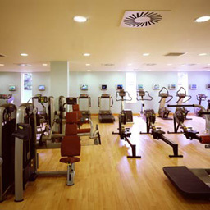
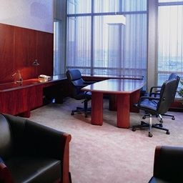
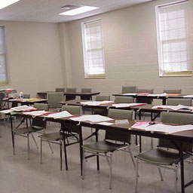
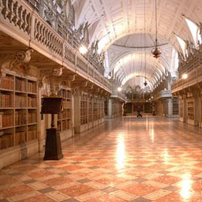
BACKGROUNDS DATASET
INDOOR SCENE RECOGNITION - CVPR 2009
15’620 IMAGES
67 CATEGORIES
[Quattoni et al. 2009]
Notes:
For the replacement, we select the indoor scene recognition dataset presented on the 9th CVPR conference. It is composed of more than 15 thousand images for 67 categories in total, which ensures a good variability during training.

Slide 18
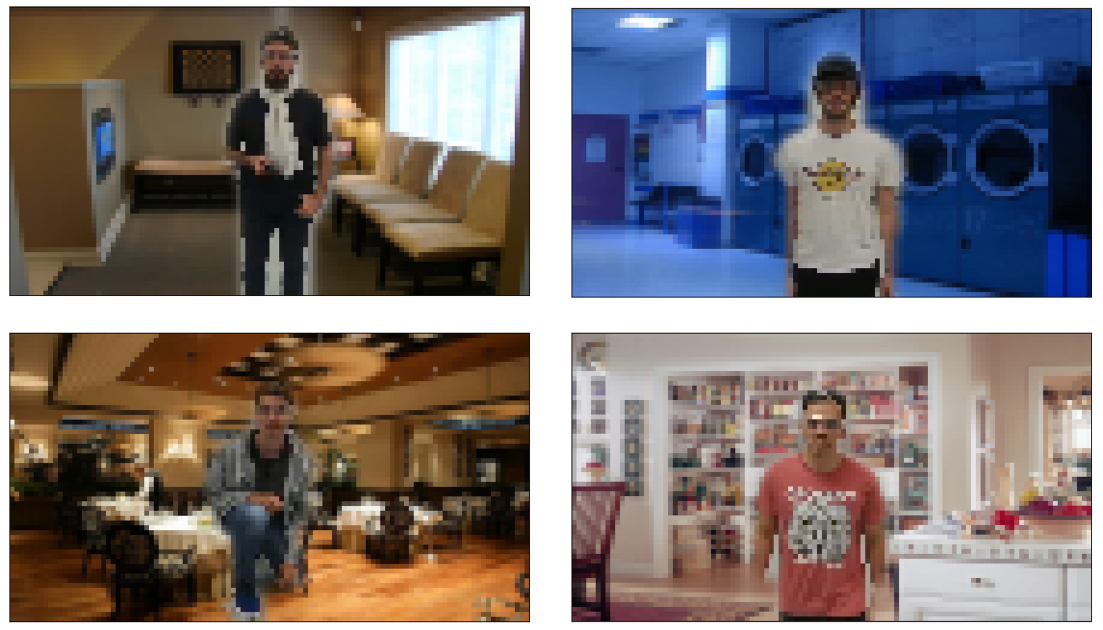
BACKGROUND REPLACEMENT
Notes:
Here, you can see an example of the background replacement for the dataset.

Slide 19
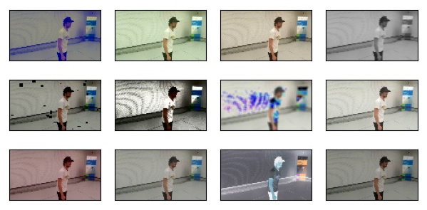
CLASSIC IMAGE AUGMENTATION
Notes:
Then, we also apply standard image augmentation through a known library, which includes a broad set of transformations for colors, brightness, contrast, and noise.

Slide 20
MODELS DEFINITION
TRAINED ON
ORIGINAL
DATASET
TRAINED ON
BACKGROUND REPLACED
DATASET
TRAINED ON
BG REPLACED & IMG AUGMENTED DATASET
ARENA MODEL
CVPR MODEL
CVPR AUG MODEL
Notes:
Given the pipeline, we define 3 model variants: A B and C, respèctively green, blue and red.
The first consider the original model as-is, being trained on the original dataset. For this reason, we call it the arena model.
The second is trained with background replacement, using the CVPR dataset, from which it takes its name.
The third and most advanced variant enables both background replacement and classic image augmentation.

Slide 21
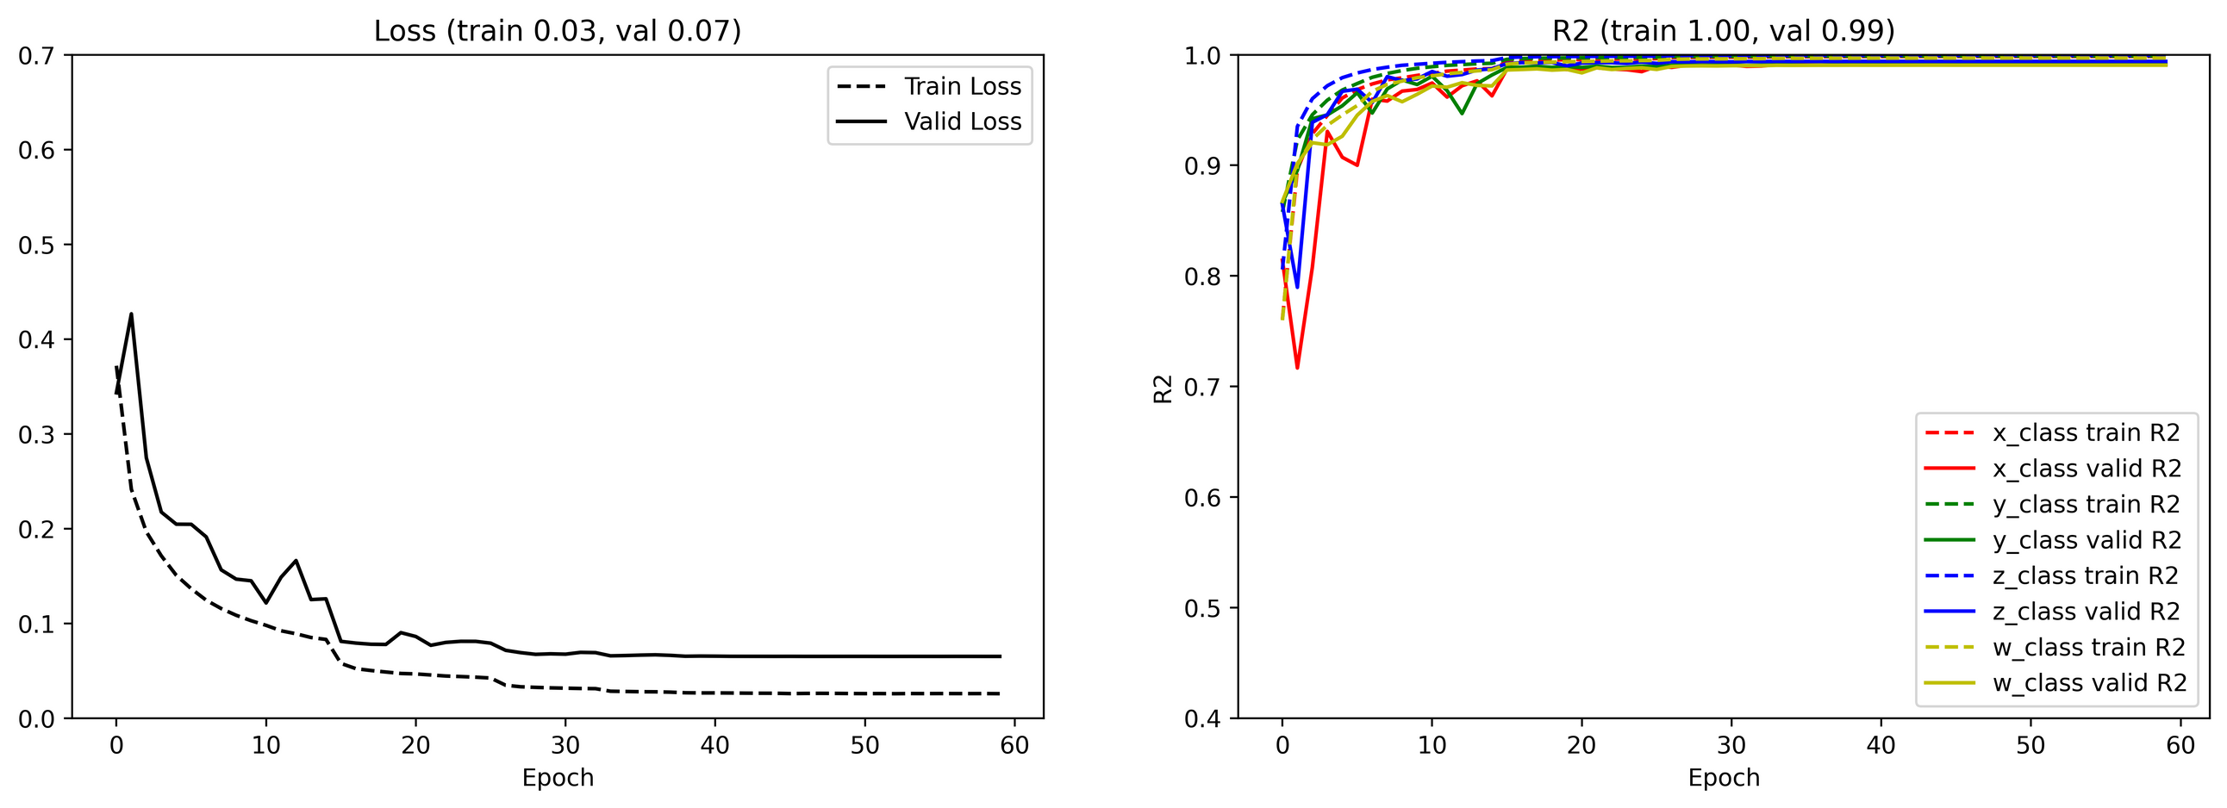
TRAINING
ARENA MODEL
Notes:
We now show the training result of the 3, considering the Mean Absolute Error loss and the coefficient of determination, also called R squared. The arena model, after 60 epochs , reaches a training and validation loss of 0,03 and 0,07. The R squared is very high around 1, which is most likely a symptom of overfitting.

Slide 22
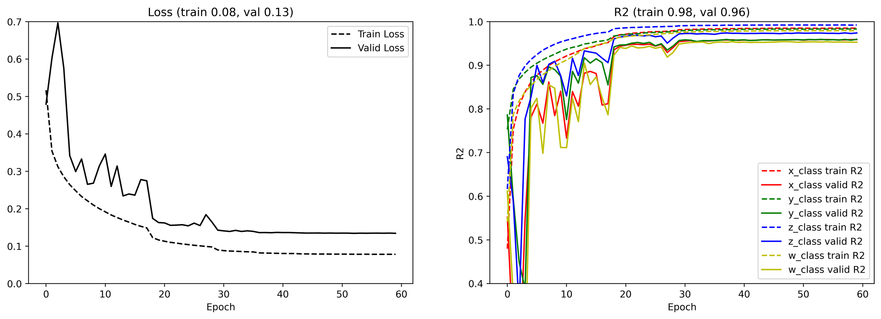
TRAINING
CVPR MODEL
Notes:
Model CVPR achieves higher loss and lower R squared. This is expected, because of the background replacement.

Slide 23
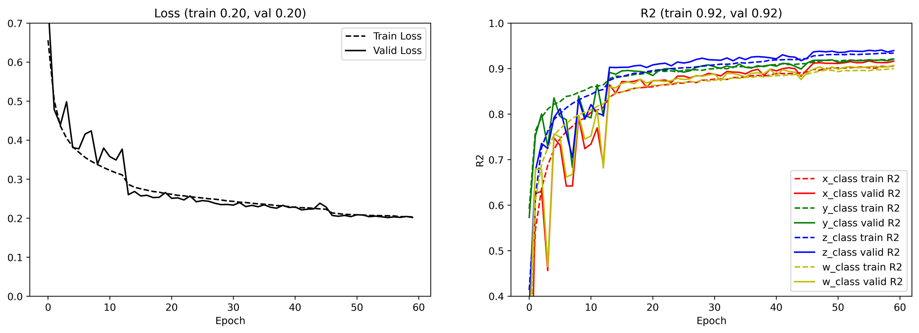
TRAINING
CVPR AUG MODEL
Notes:
Lastly, model C registers even worse loss and R squared. However, the gap between training and validation metrics is highly reduced, hopefully because of better generalization capabilities.

Slide 24
MULTIPLE EVALUATIONS
TO VALIDATE THE SOLUTION
23
Notes:
Now that we have trained our models, we can observe the results of multiple evaluations, conducted to validate our solution and approach.

Slide 25
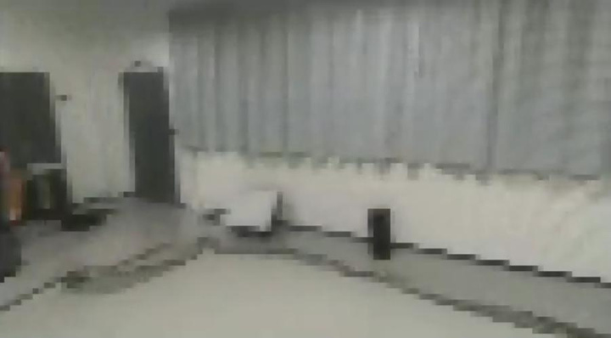
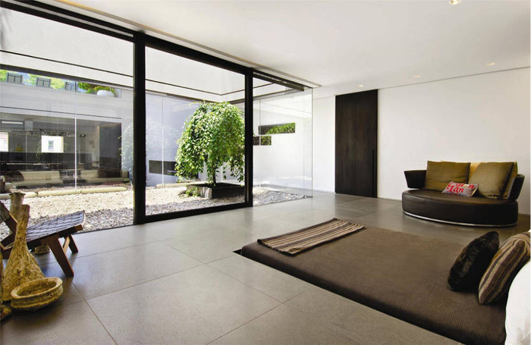
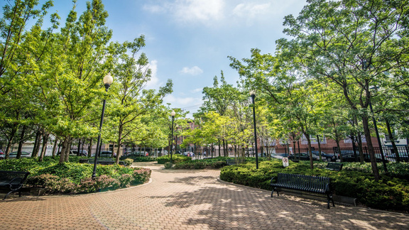
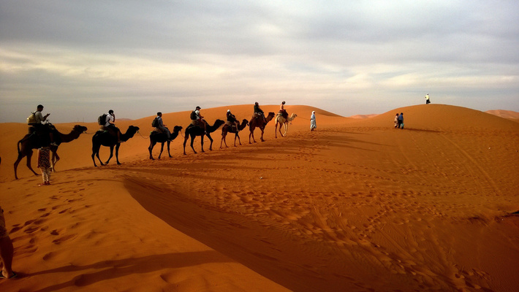
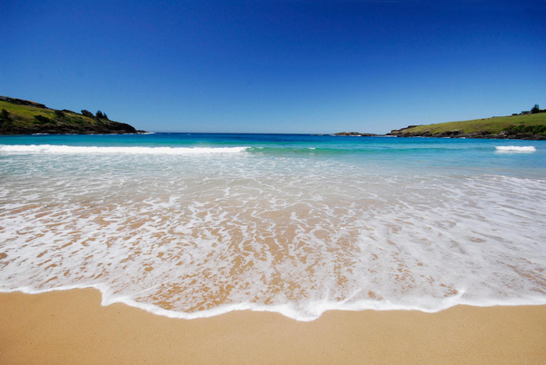
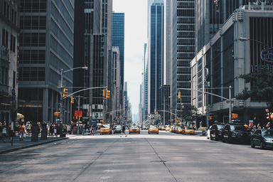
TEST SETS DEFINITION
many more ...
ARENA
TEST SET
INDOOR 1
TEST SET
MIXED
TEST SET
24
Notes:
For testing, we present 3 datasets. The first, named arena, is the original test set made available from the original paper. The others, are created from the first by applying background replacement as we did before.
In this slides, we consider a single background test set, indoor 1, in the center, and a multiple backgrounds test set, that we call mixed.

Slide 26
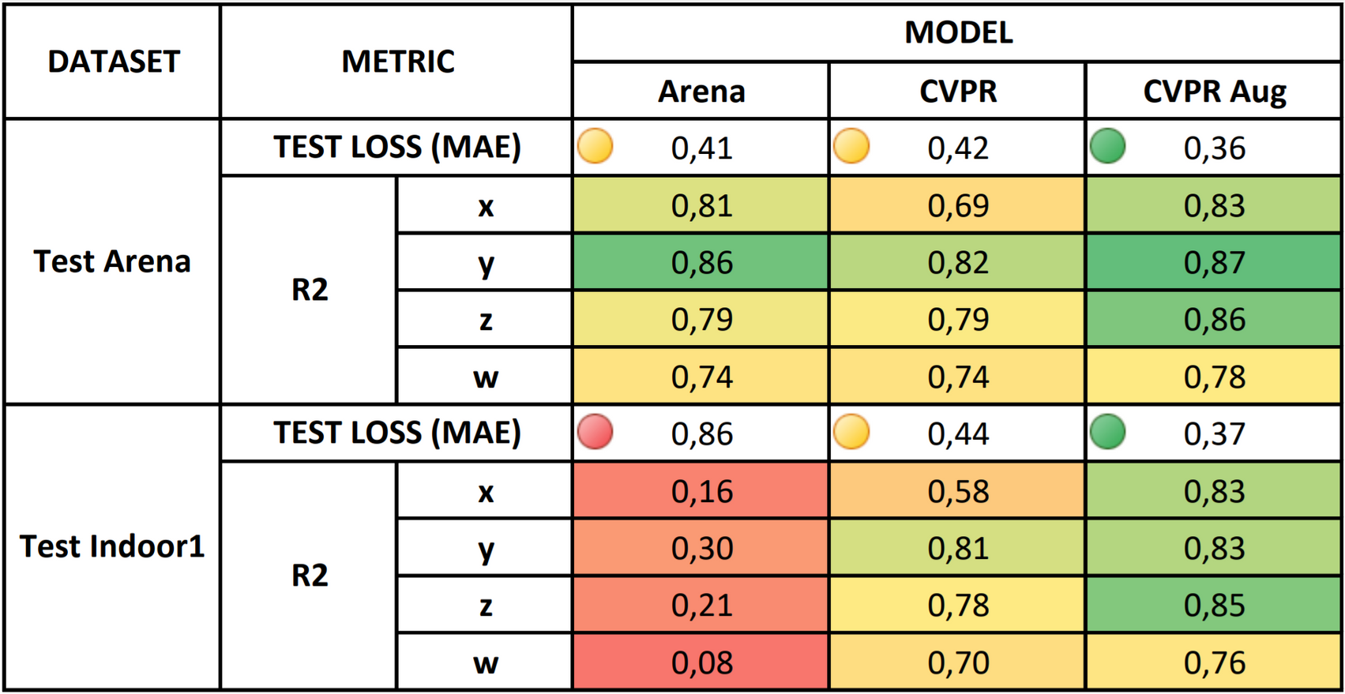
QUANTITATIVE EVALUATION
25
Notes:
We run the inference on the given test sets for a quantitative evaluation first.
Let's start reading the table by considering the arena test set, on the first rows. We observe that the arena model has a loss of 0,41, very similar to the one obtained by the other two models. Also, the R squared is comparable among the three, being between 0,74 and 0,87. Model C register better results than A, even the model is not even trained inside the drone arena.
Results are very different on the indoor1 test set. Arena model performance degrades a lot both in terms of loss and R squared. The worst metrics are seen for variables X and W. On the contrary, the other 2 models do not register big differences from before.
Here, classic image augmentation seems very important, especially for variable X, which is the major increase you can notice between models B and C.

Slide 27
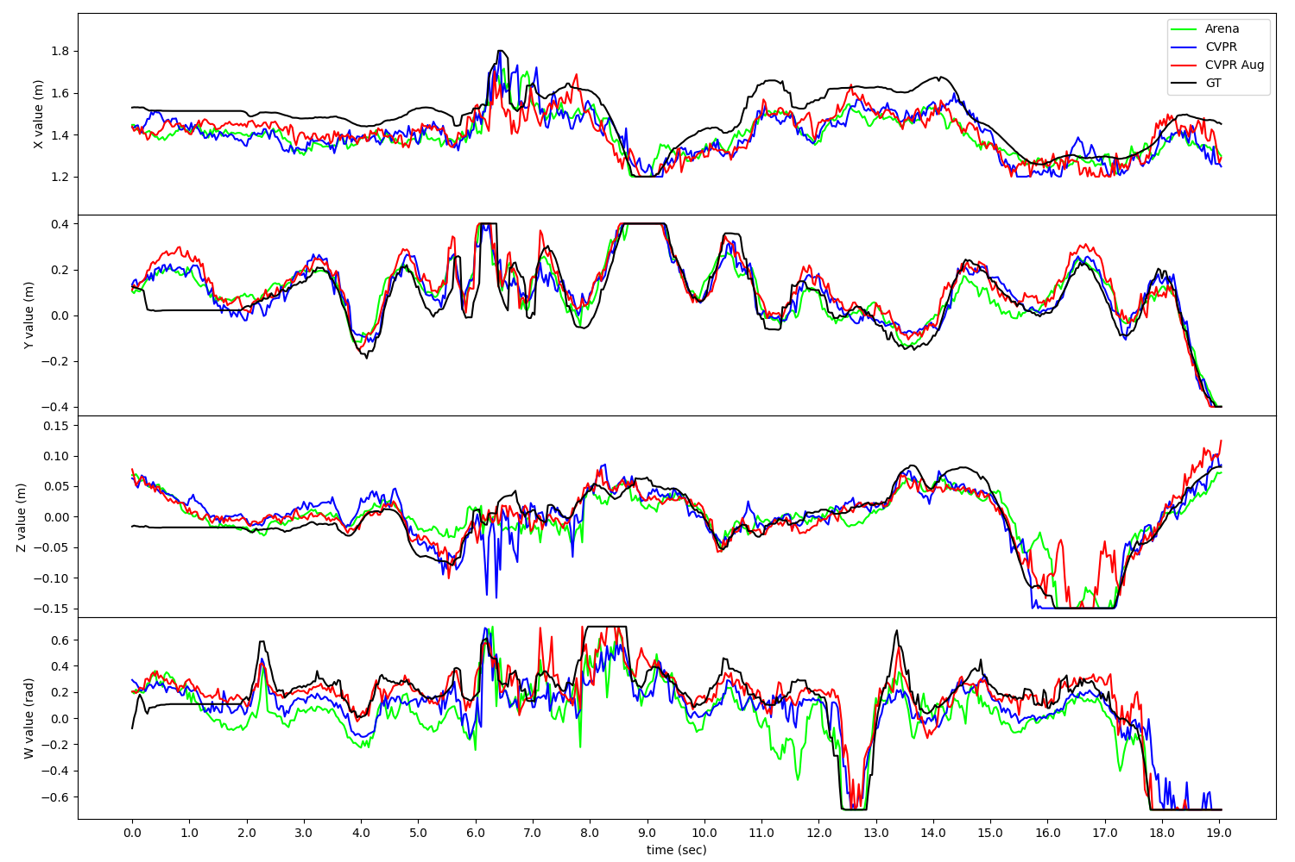
TIMELINE EVALUATION: ARENA TEST SET
26
Notes:
After quantitative, we bring our reason to a qualitative viewpoint.
In this chart, we simulated about 20 seconds of predictions on the arena test set, for the 4 variables you see in the rows. All the models are shown, respèctively in green, blu and red. The ground truth is black.
For all variables, every model is able to follow the ground truth properly.

Slide 28
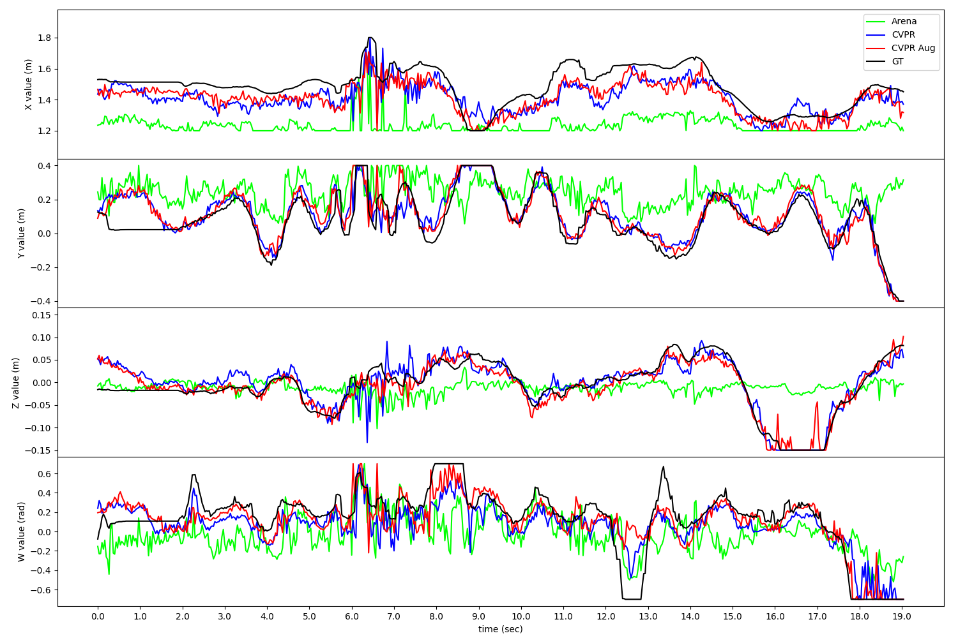
TIMELINE EVALUATION: INDOOR 1 TEST SET
27
Notes:
When we switch to the indoor 1 test set, the situation changes. While the models defined with our augmentation pipeline, so the blue and red ones, are still able to produce outputs similar to the ground truth, the original model is making significantly wrong predictions for all the variables.

Slide 29
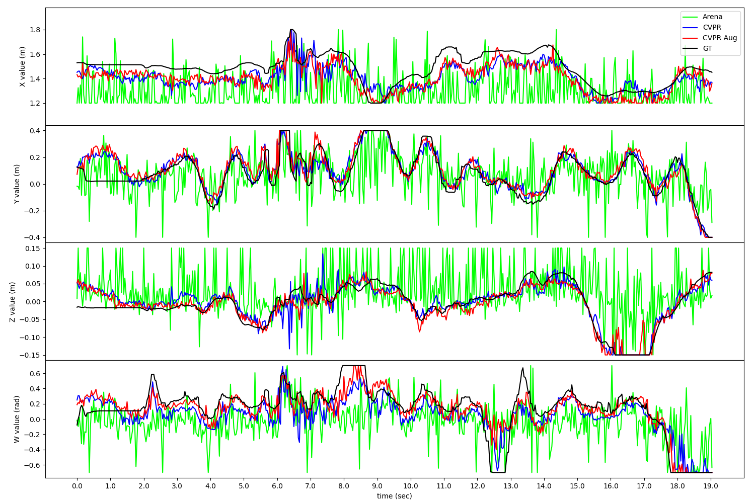
TIMELINE EVALUATION: MIXED TEST SET
28
Notes:
This effect is even stronger on the mixed test set, in which the green model produces highly oscillating outputs. This confirms the sensitivity of the model to the background, since, in this test set, consecutive samples have different backgrounds.

Slide 30
PER-FRAME EVALUATION: ARENA TEST SET
https://www.youtube.com/watch?v=VvESz9tJqE8
29
Notes:
Our last evaluation considers interactive visualization of the predictions. On the borders, values of the 4 variables are shown for both the models and the ground truth.
X, on the left, is the user's distance from the camera. Y, on the bottom, the horizontal alignment. Z, on the right, the vertical alignment. W, on the top, the head's orientation.
In this simulation, as seen before, all the variables follow the ground truth.

Slide 31
PER-FRAME EVALUATION: INDOOR 1 TEST SET
https://www.youtube.com/watch?v=-pII8ujJEng
30
Notes:
Conversely, on the indoor1 test set, we observe models blue and red to be more robust, especially for the Z variable.... like... now. The same is for W

Slide 32




SMARTPHONE EVALUATION
32
Notes:
To further confirm our approach validity, we test the model on new images. We use a smartphone to record videos in different scenarios: in parks or streets, and even with faces partially covered or with low light conditions. In all these frames, the red model's predictions are perfect while green and blue sometimes provide incorrect results.

Slide 33
SMARTPHONE EVALUATION
https://www.youtube.com/watch?v=C37qapV6CbQ
33
Notes:
This video focuses on the Z variable, on the right, clearly showing that only the red model appropriately follows the user.

Slide 34
SMARTPHONE EVALUATION
https://www.youtube.com/watch?v=KWb3RNbr7Lk
35
Notes:
Results are also satisfying with fast-moving users, even if they don't face the camera directly. This is surprising since the training set only contains users actually facing the drone. Once again, red model is more robust especially for variables X and Y.

Slide 35
SMARTPHONE EVALUATION
https://www.youtube.com/watch?v=KWb3RNbr7Lk
34
Notes:
We also consider multiple people in the frame. In some cases, the network attaches to the foreground person, as expected, but sometimes it struggles with uncertainty. However, when a user exits the field of view, the model instantly focuses on the remaining one.

Slide 36
CONCLUSIONS
QUANTITATIVE AND QUALITATIVE EVALUATION PROVED THAT THE AUGMENTATION STRATEGY
IS ABLE TO ENHANCE MODEL'S GENERALIZATION
BOTH BACKGROUND REPLACEMENT AND
CLASSIC IMAGE AUGMENTATION ARE
REQUIRED TO OBTAIN ROBUST RESULTS
OUR APPROACH IS EXTENDABLE TO OTHER TASKS WHICH REQUIRES OBJECT OR HUMAN RECOGNITION
36
Notes:
We conclude here the evaluation.
Quantitative and qualitative results proved that our augmentation strategy is able to enhance the model's generalization ability.
Both background replacement and classic image augmentation are required to obtain robust results.
In light of this, our approach can be extended, to augment other datasets for object or human recognition.

Slide 37
FUTURE WORKS
TEST THE MODEL ON THE REAL DRONE
FURTHER INTERPRETATION ON THE NEW MODEL
TEST THE AUGMENTATION STRATEGY ON DIFFERENT DRONES
37
Notes:
As future works, we aim to test the model on the real drone, which is a Parrot Bepop 2.
We would also like to apply new model interpretation techniques on the trained network. And, finally, we want to test our strategy for achieving the same task with different drones.

Slide 38
THANKS FOR YOUR KIND ATTENTION
Supervisors:
Prof. Alessandro Giusti
Prof. Giovanni Denaro
Master Thesis by
MARCO FERRI
ID 80730
Co-Supervisor:
Dr. Dario Mantegazza
Notes:
Thank you so much for your kind attention, I hope you liked my presentation.

Slide 39
ADDITIONAL SLIDES

Slide 40

HOW GRAD-CAM WORKS
[Selvaraju et al. 2019]

Slide 41

HOW GRAD-CAM WORKS
[Selvaraju et al. 2019]

Slide 42








GRAD-CAM: FROM REGRESSION TO CLASSIFICATION

Slide 43

GRAD-CAM PER CLASS

Slide 44

GRAD-CAM PER CLASS

Slide 45


TIMELINE EVALUATION: INDOOR 2 TEST SET
28

Slide 46
PER-FRAME EVALUATION: MIXED TEST SET
https://www.youtube.com/watch?v=MyYROdi2FR4
31

Slide 47
SMARTPHONE EVALUATION
https://www.youtube.com/watch?v=3oTPaV-ZuIc
30

Slide 48
SMARTPHONE EVALUATION
https://www.youtube.com/watch?v=zrp12f4aYCI
30

Slide 49
ADDITIONALS
QUALCOSA SU MASK R-CNN ?? DIFFICILE
ALTRI VIDEO DA SMARTPHONE

